Slide 1

How to Close a Sale
Chapter 15 Closing the Sale
Section 15.1 How to Close a Sale
Section 15.2 Customer Satisfaction and Retention

Slide 2
How to Close a Sale
Objectives
Identify Four Methods for closing a sale
Marketing Essentials Chapter 15, Section 15.1

Slide 3
The Selling Process
All efforts up to this step of the sale have involved helping your customer make buying decisions.
Seven key steps to selling:
Approaching the customer: Greet the customer
Determining needs: what the customer is looking for
Presenting the product: Educate the customer about the product’s features and benefits
Overcoming objections: Learn why the customer is reluctant to buy and providing information to remove that uncertainty

Slide 4
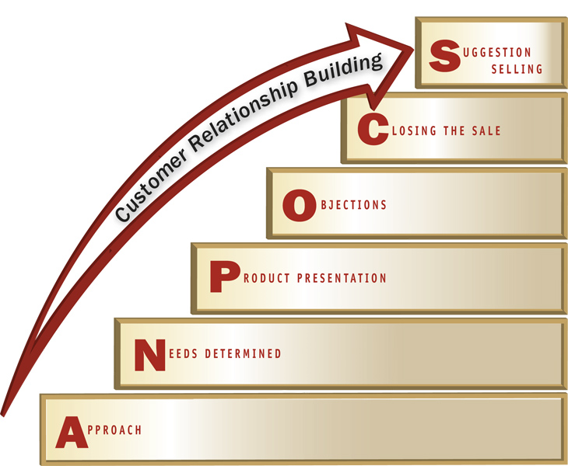
The Selling Process: Remaining is about getting customers to buy
Closing the sale: Get customer’s agreement to buy
Suggestion selling: Suggest additional merchandise that will save customer money or enjoy the original purchase
ex: Best Buy- after laptop purchase you can get a printer for ½ off
7. Relationship building: Create a means of maintaining contact with the customer after the sale is done
Marketing Essentials Chapter 13, Section 13.1

Slide 5
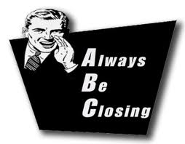
Closing Concepts and Techniques
Closing the sale X The process of obtaining a positive agreement from the customer to buy.
Marketing Essentials Chapter 15, Section 15.1

Slide 6

Specialized Methods for Closing the Sale
How you close depends on the selling situation. Use one of Four Specialized Closing methods to close:
Which close
Standing-room-only close
Direct close
Service close

Slide 7

1. “Which Close” Method
Which close X method of closing a sale that encourages a customer to make a decision between two items
Examples: Then ask the customer,
“Which one do you prefer?”
“Do you like the Samsung or the LG
Marketing Essentials Chapter 15, Section 15.1

Slide 8
2. “Standing-room-only” Method
Standing-room-only close - method of closing a sale that is used when a product is in short supply or when the price will be going up in the near future
Should be used only when the situation honestly calls
Can be perceived as a high-pressure tactic
Often used in real estate
Example:
“I’m sorry, but I can’t promise that I’ll be able to make you this same offer later.”
“This one time offer is only good for 24 hours.”

Slide 9

3. Direct Closing Method
The direct close X is a closing method in which the salesperson asks for the sale.
Used when the buying signal is very strong
Example:
Can I assume that we're ready to talk about the details of your order?
Can I draw the contract up for this deal?
You appear to like everything you have seen. Now we need to discuss the quantity you need?
How would you like to pay for this purchase?

Slide 10

4. Service close
Service close X is a closing method in which the salesperson provides special services that overcome obstacles or problems
Such services could be:
A return policy (important for buying gifts for others)
Special sales arrangements (payment options)
Warranties
Bonuses or premiums

Slide 11
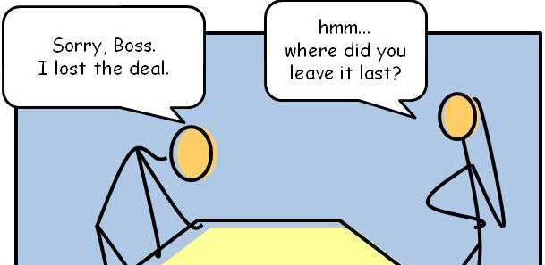
Failure to Close the Sale
Your attitude when you did not make a sale should be no different than when you did
Always smile and be friendly, sale or no sale
Keep in mind that a customer who does not make a purchase is still a prospect for future business
A request for feedback and any other constructive criticism may work for you if you have earned the buyer’s respect
If you clearly sense you are about to be turned down, it is better to make a graceful exit, leaving the door open for a future sales call.

Slide 12
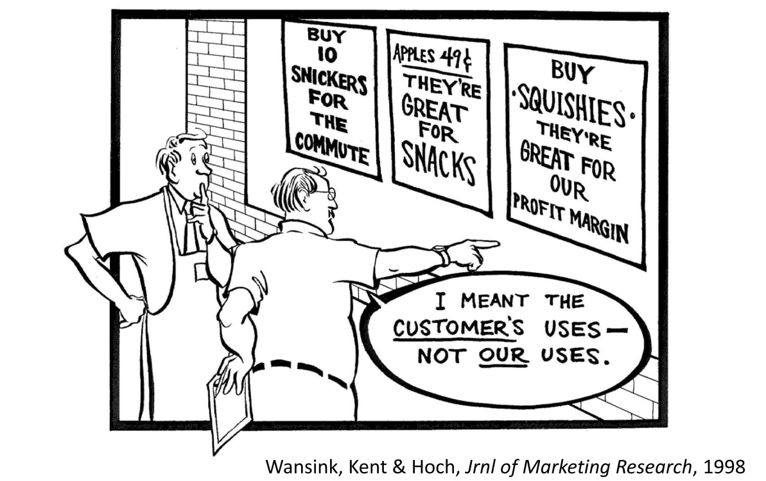
Suggestion Selling
Suggestion selling X method of selling in which the salesperson recommends additional goods or services to the customer
Selling other items with the original purchase that will save the customer time or money
Done after the commitment to buy the original item
Marketing Essentials Chapter 15, Section 15.2

Slide 13

a.k.a Cross selling – suggesting merchandise related to the original purchase
Easiest and most effective suggestion selling method
Example
“Can I get you some black socks to go with those shoes?
“We have some bright colored tees that can easily been seen on the greens”.

Slide 14
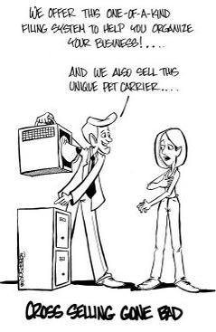

Slide 15
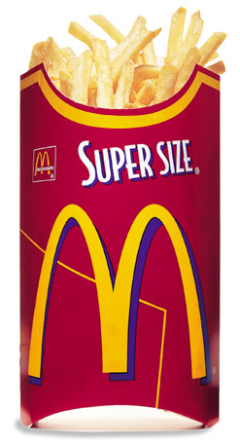
up-selling – salesman gets customer to purchase more expensive items, upgrades, add ons or larger quantities to increase sales
In business-to-business, larger quantities may qualify the buyer for discounts, flexible payment terms, or reduced delivery charges
Example:
Bulk purchasing – buy 20 for $5 per item or buy 30 for $4 per item
If you purchase 40 today instead of 30, your delivery charges will be free
For $1.00 you can get a super size meal

